Slide 1
Project HUB
A web application for automatically transmit data from lake to project space
Notes:
The purpose of the presentation today is ..
I will explain to you
-
- The main architecture of the project

Slide 2
Projet Hub – Problem Statement
Lake
/lake/bddf/axxx_tri/…
(Stockage brut)
Project 1’s treatment
Projet
/project/bddf/project1: subset1 of axxx_tri
…
/project/bddf/projectn:
subset2 of axxx_tri
Source 1
Source 2
…
…
Project 1’s treatment
Source n
Current solution
Projects need to get subsets of data from data-lake for further usages.
Each project needs to get access to the whole data source
Each project has to develop its own treatments.
Security: The project access to more data than what it needs
Cost: Each project develops its own treatment for quite same purpose
Notes:
Data from different sources are collected in the data-lake. Subsets of these data need to be transmitted from lake to project space for further exploitation.
In order to make this transmission, each project needs have two things:
first, it needs to have access to the whole data source (even though it only needs a subset of data from this source)
Second, it needs to have its own treatment for the transmission
This causes 2 problems
Security: The project has access to more data than what it needs
Cost: Each project develops its own treatment for quite same purpose.
Also, we are evolving from building our solutions use case by use case to a service that can be consume by multiple use cases. So we really want to make this dissappear

Slide 3
Projet Hub – Problem Statement
Lake
/lake/bddf/axxx_tri/…
(Stockage brut)
Projet
/project/bddf/project1: subset1 of axxx_tri
…
/project/bddf/projectn:
subset2 of axxx_tri
Source 1
Source 2
HUB treatment
…
Source n
Project HUB
Security: Prevent the risk of having a lot of people accessing data that they are not supposed to access to
Cost: Standardize the way to deliver data for end-usage
The data-lake layer will eventually become more and more unreachable without a manage service layer
Notes:
For these reasons, this project will aim to change the way projects consume the raw data stored in the data-lake. In particular, it will prevent the risk of having a lot of people accessing data that they are not supposed to access to, and standardize the way to deliver data for end-usage. The data-lake layer to eventually become more and more unreachable without a manage service layer.

Slide 4
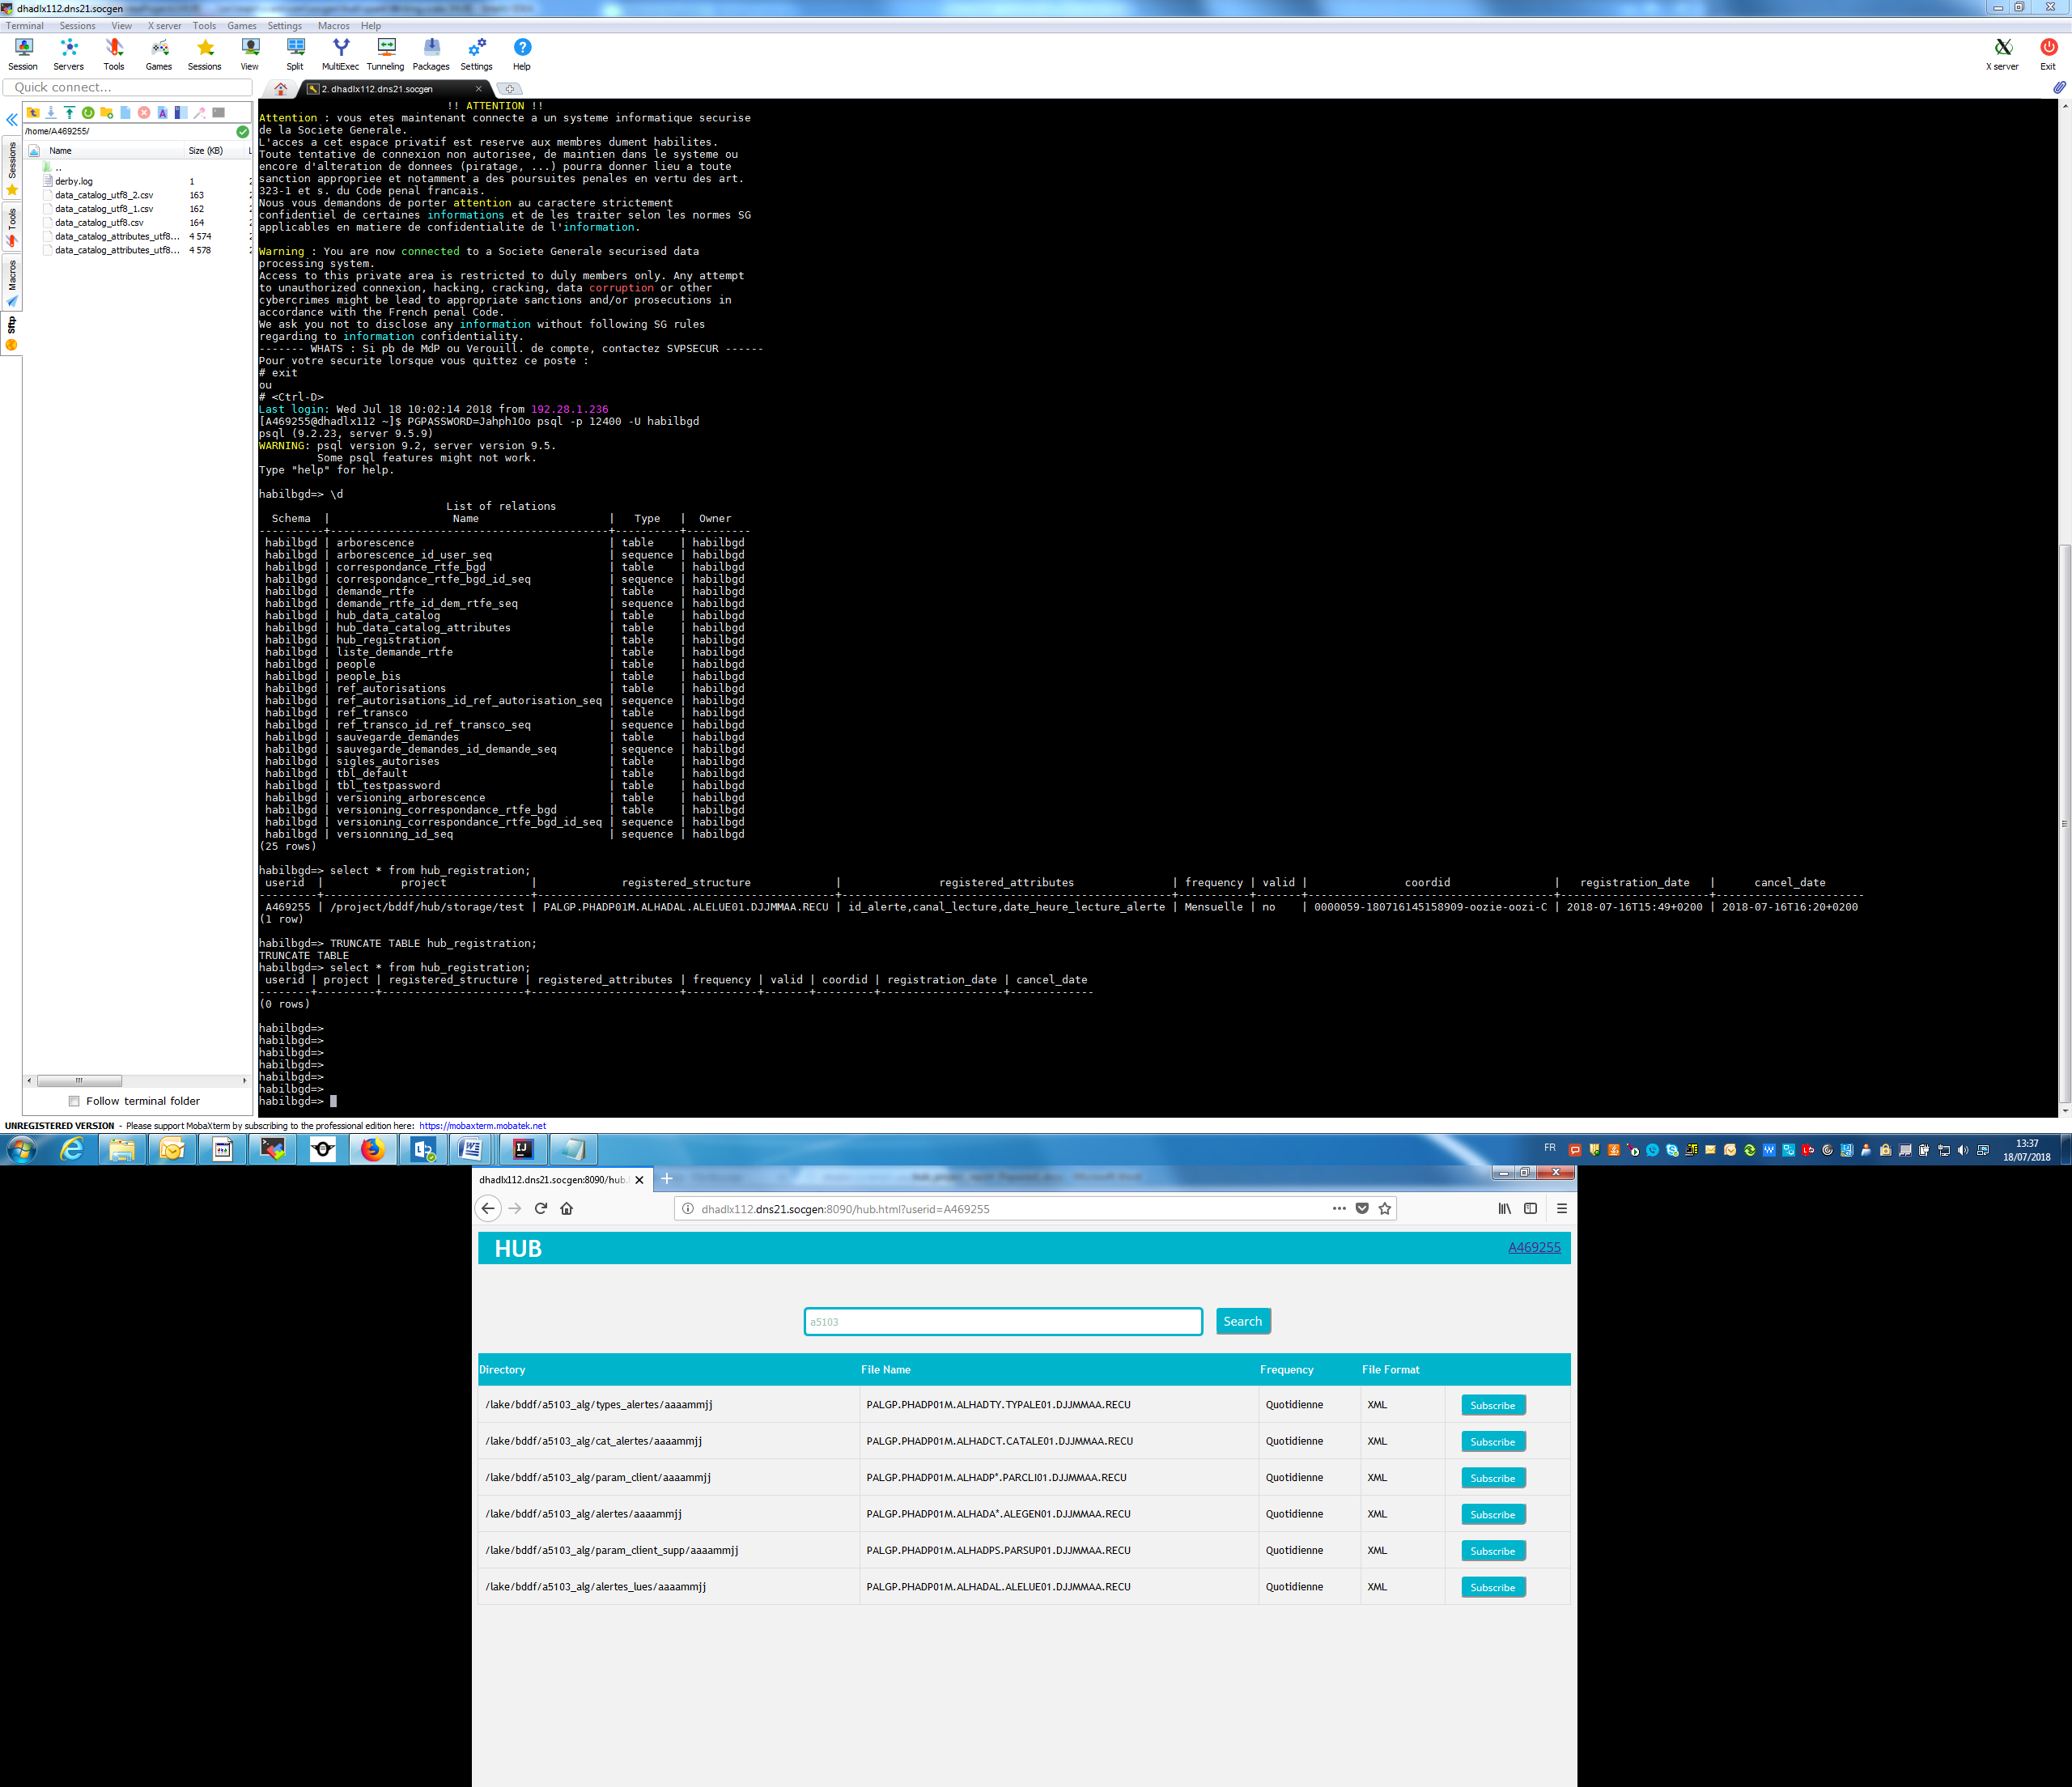


Projet Hub - Goal
Parameters: Search file structure, subscribe/unsubscribe to a file structure
Server Apache
Lake
Project
Oozie
Transmit
A web application
Allows users to select a structure & subscribe or unsubscribe to schedulers
Schedulers: automatically transferring subsets of data required by a project from data-lake to the project’s space using the input parameters received from the web application
Notes:
To address these needs, we will implement a web application that allows users to subscribe or unsubscribe to data structures through schedulers. These schedulers will be responsible for automatically transferring subsets of data from sources in the data-lake to the project’s space using the input parameters received from the web application. The parameters are for example the application ID code, columns of interest, frequency and output file format.

Slide 5
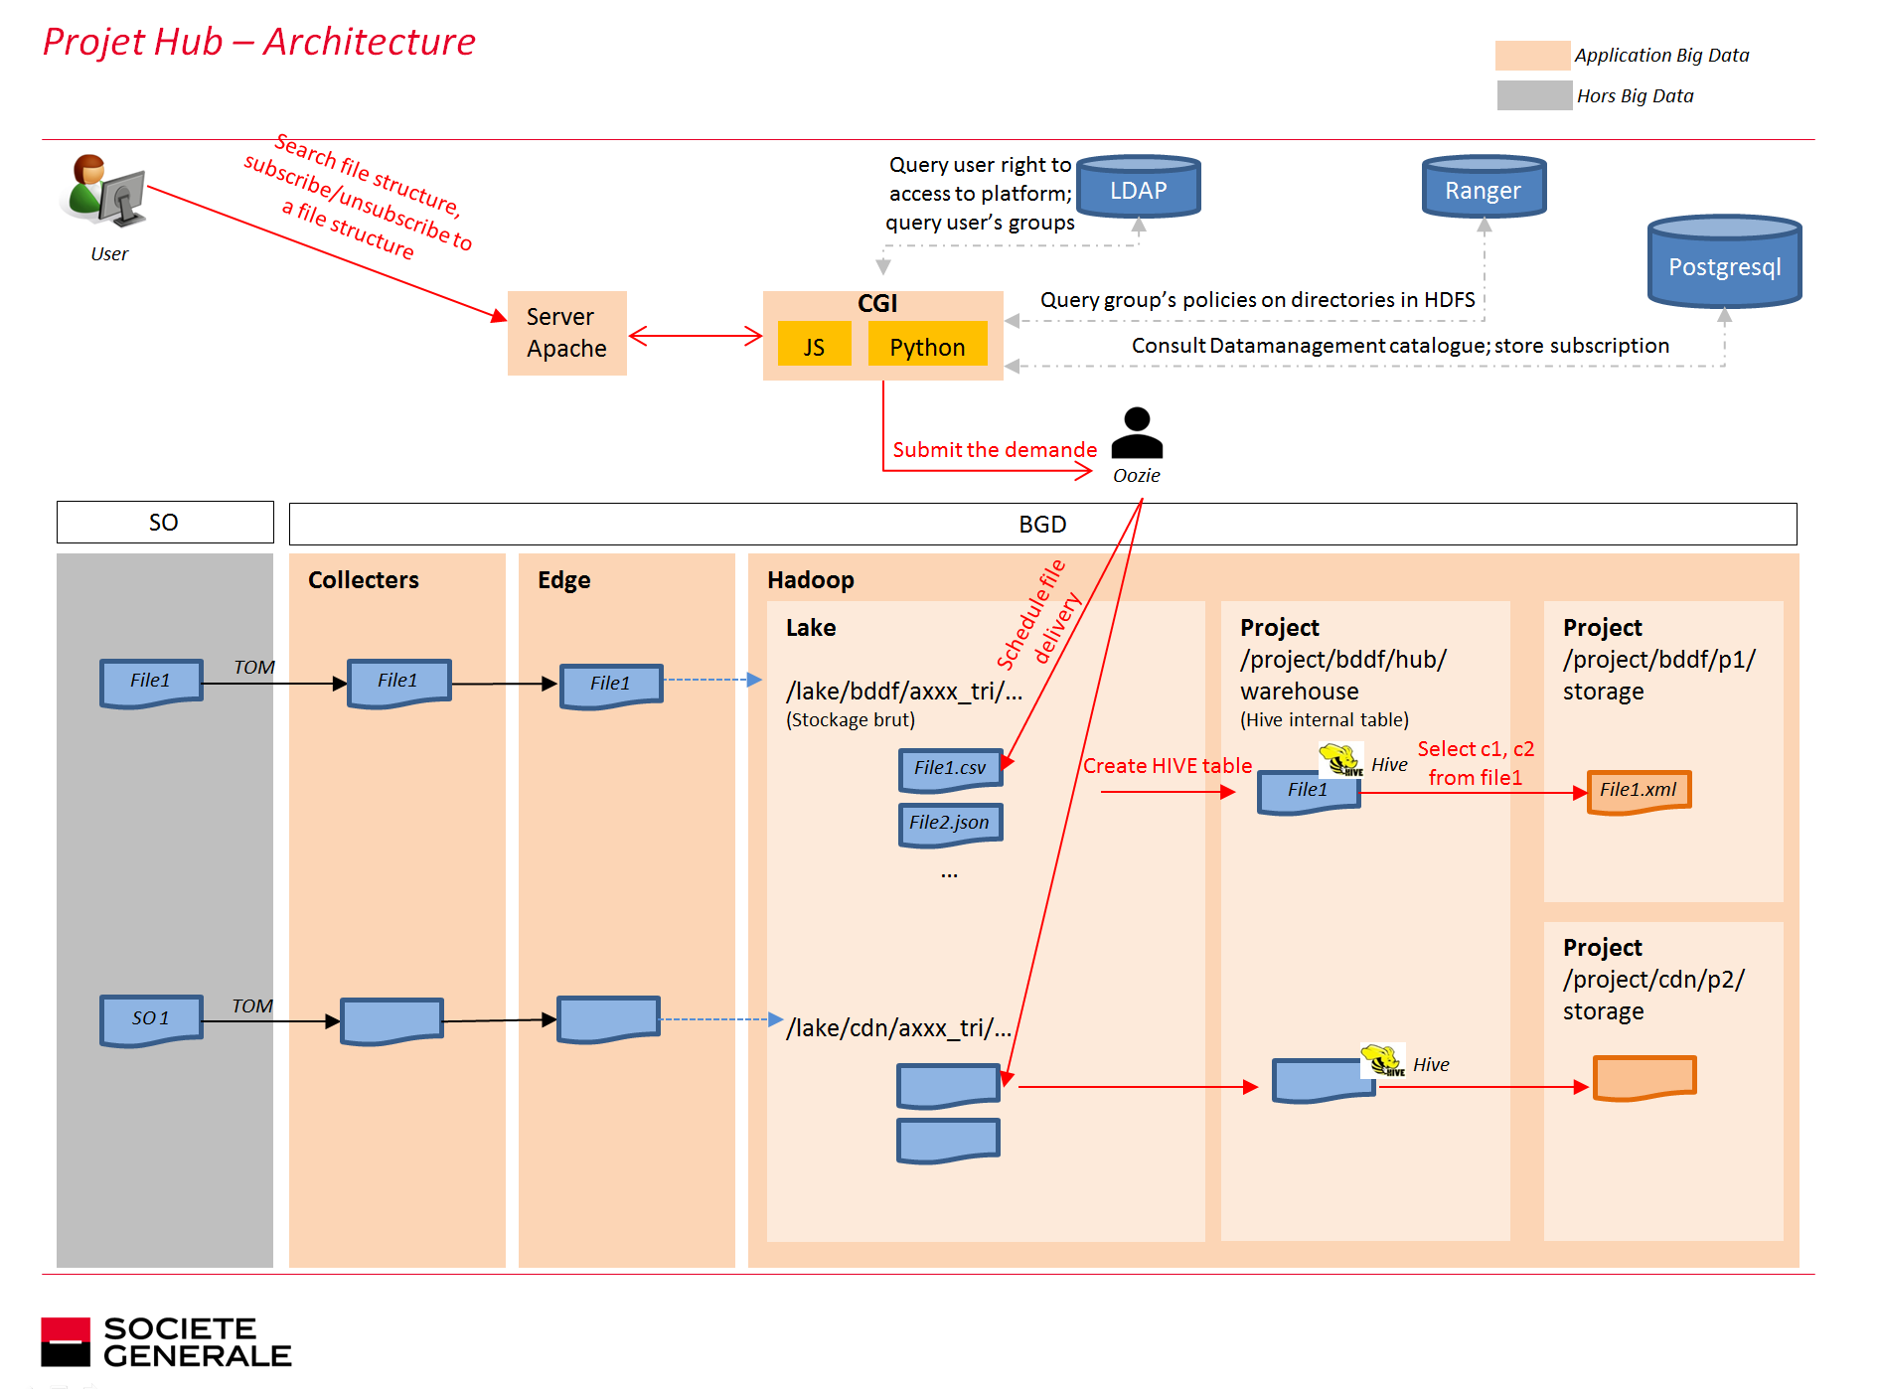
@dhadlx112.dns21.socgen:8090
project/cdn/hub/warehouse
Notes:
This is the simplified version of the project architecture.
Users will interact with the web application interface to specify his demand. The demand can be for example…. This application runs on an apache server which I put at this host. When a demand is made, the apache server will trigger the appropriate python script which will serve the demand. I put the script on the server in the way that it can be executed on the apache server as if it was running in a command line, and this is basically called CGI.
In details, it’s like this:
Here I have a JavaScript that is used for parsing user inputs from html forms and execute the appropriate python scripts using these inputs. The python scripts can first use cgi library to load and read these input parameters then perform further operations such as: authenticate the user, search for file structures and their attributes, and serves the subscribe/unsubscribe request using an oozie coordinator application. I will show you in details on the next slides how these operations are done.

Slide 6
Projet Hub – Login [Python]
LDAP
UserName
Password
True/False
Notes:
First is the login. In order to authenticate the users, it first gets the username and password from the login.html form using cgi library. Then, in order to check for user identity, the script will try to connect to the “User” Orgnizational Unit of LDAP using this username and password. If the connection is successfully established, it means the username and password provided by the user match that of the LDAP database. In this case, the user will be authenticated.

Slide 7
Projet Hub – Search for files(1) [Python]
Postgresql (DataCatalog)
AppID
AppDir,structureNames
LDAP
Ranger
UserName,
AppDir
Groups
Group’s policies on AppDir
Postgresql
(DataAttributes)
structureName
structureAttributes
Notes:
After the user is authenticated, he will be allowed to search for file.
Query UserGroups on the “Groups” Orgnizational Unit of LDAP using UserName and AppDir

Slide 8
Projet Hub – Subscribes [Python, Scala]
Trigger spark jar
UserID, SubscribedStructures,Dir,Columns,Frequency,…
Write to postgreSQL
Coordinator Application
Phrase 1: Python
UserID, SubscribedStructures,Dir,Columns,Frequency,…
Dataframe
Write Dataframe
to outputDir
Phrase 2: Scala
Notes:
Next, the user will be able to make his subscription by choosing ….
Then it will deploy the oozie application using these
Create a dataframe for all the files selected by the user, select the appropriate columns from this df and write …
All of this will happen again and again with the freq similar to what being entered by the user

Slide 9
Projet Hub – Unsubscribe
Postgresql (registration)
UserID, SubscribedStructures,
OuptDir
coordinatorID
kill(coordinatorID)
Update postgreSQL DB
Notes:
The user will be able able to say I want to unsubscribe to something.
In the unsubscribe phrase

